Slide 1
GitHub Copilot Onboard
Quickstart Guide
JANUARY 2024

Slide 2
Contents
Setup GitHub Account
Install VS Code
Install GitHub Copilot and GitHub Copilot Chat Extensions
Connect to GitHub
Get Started With GitHub Copilot

Slide 3
Create GitHub Account
Setup using Personal or @cognizant.com email
If using Personal email / Additional Steps
Launch Github.com (https://github.com) in your browser
Click Sign Up
Provide your email and create a password
Choose a username (this is your “handle” and can change if you like)
Verify your account by completing the captcha
Click Create Account
You’ll receive a verification code to your email, enter this and continue with answering the onboard survey
Click the Avatar Icon chosen for you in the upper right-hand corner and select SETTINGS
On the Settings page, look for a section called ACCESS on the left-hand side of the page.
Click EMAILS
Add your Cognizant email (e.g. firstname.lastname@cognizant.com) this is what will allow IT to connect your account with the Cognizant GitHub Enterprise, and onboard you to Copilot.

Slide 4
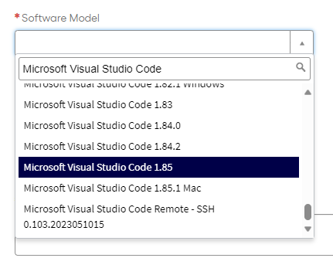
Install VS Code
Request from ServiceNow (Cognizant Standard)
Download from Microsoft.com (Blueprint Device)
Launch browser and navigate to https://ctsccprod.service-now.com/ss?id=ss_home_page_servicenow
Click Requests
Choose Request Software Asset
Fill in appropriate details for all Fields
In Software Model type ‘Microsoft Visual Studio Code’ it will filter on available versions
Choose version 1.85
Complete the request
Wait for approval and assignment
Launch browser and navigate to https://code.visualstudio.com/Download
Select the installer for your particular OS
Move the file out of DOWNLOADS into any other folder or onto your desktop
Run the installer and complete the installation

Slide 5
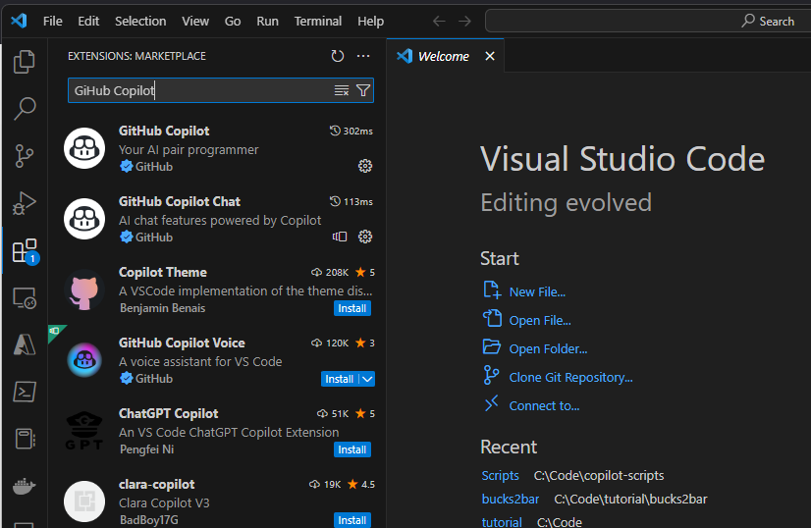
Install GitHub Copilot and GitHub Copilot Chat Extensions
Launch browser Visual Studio Code
Click VIEW -> Extensions (keyboard Ctrl+Shift+X)
In the Search box type ‘GitHub Copilot’
Click Install next to each Extension you wish to Install

Slide 6
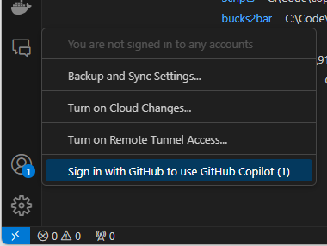
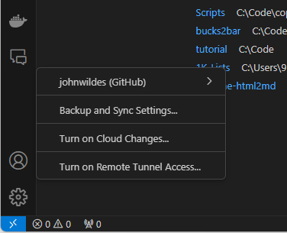
Connect to GitHub
Before Sign-in
In the lower left-hand side of the VS Code Screen click the Accounts Icon referenced in the screenshot ->
Click ‘Sign in with GitHub to use GitHub Copilot’
Complete the GitHub Authentication
Check the Accounts Icon to ensure that your GitHub Account is connected
After Sign-in

Slide 7
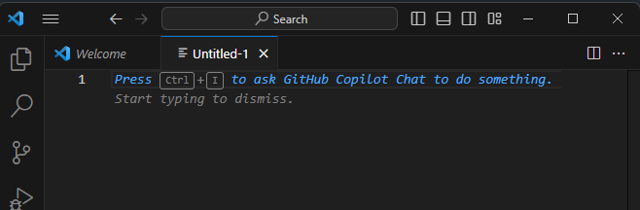
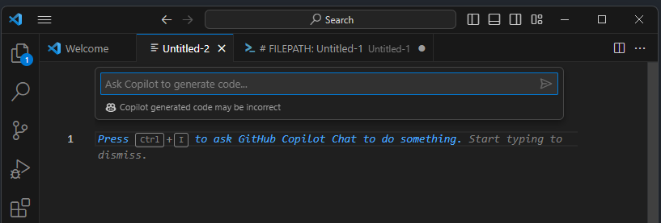
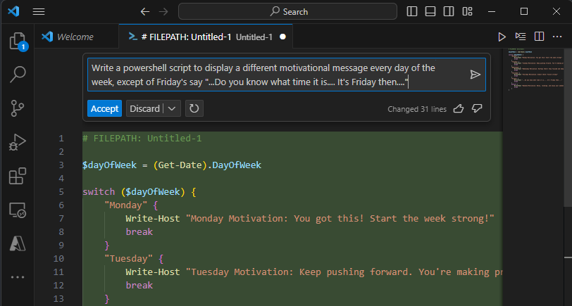
Get Started with GitHub Copilot
Create a new text file in VS Code (keyboard CTRL+N)
Press CTRL + I to launch the GitHub Copilot inline chat box
Provide Copilot a prompt, you can use one similar to the prompt shown in the third screenshot. Be creative and be surprised at the power of Copilot
Check the following links to learn more!
GitHub Copilot · Your AI pair programmer
Getting started with GitHub Copilot - GitHub Docs
What is GitHub Copilot? (Part 1 of 6) | Microsoft Learn
Introduction to GitHub Copilot - Training | Microsoft Learn
Get Started with the Future of Coding: GitHub Copilot (youtube.com)

